Slide 1
HTT splicing enhancer on-target and off-target effects (2nd data set)
Aug 26, 2022
HTT Group Meeting
Zhen, Dann, Catherine, Joon, Magnus, Jessica

Slide 2
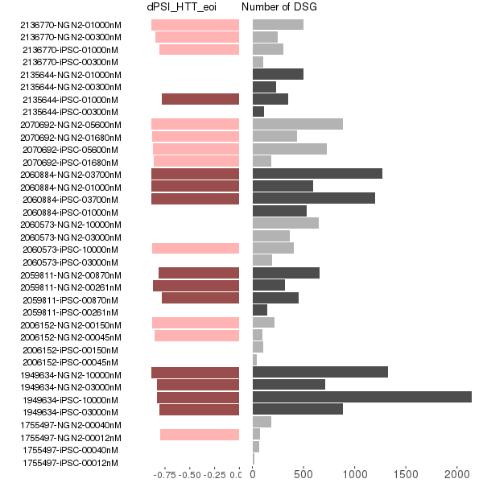
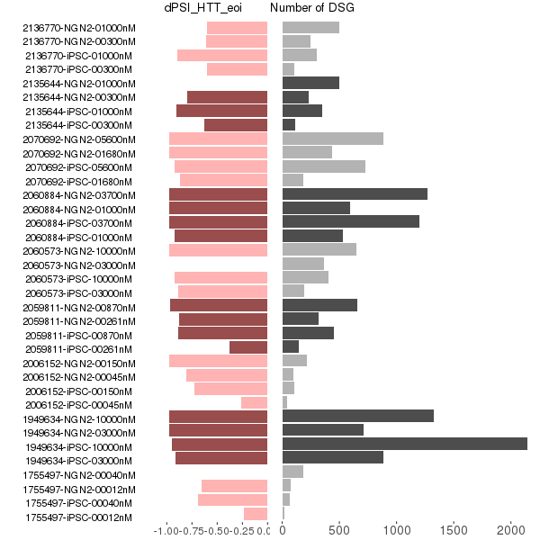
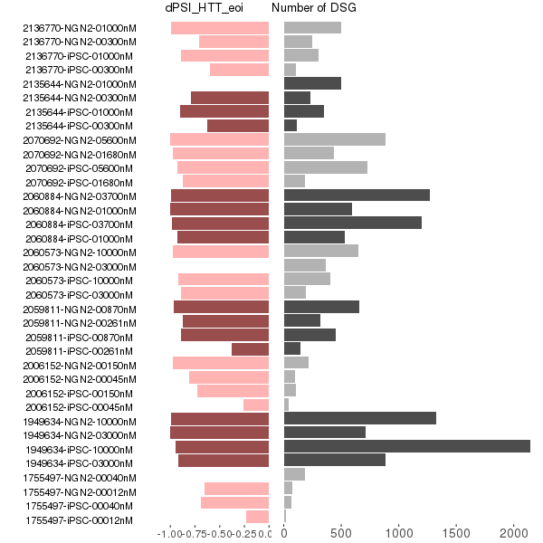
DSG and dPSI in eoi
dPSI from majiq
leafcutter majiq merged
Updated dPSI from leafcutter

Slide 3
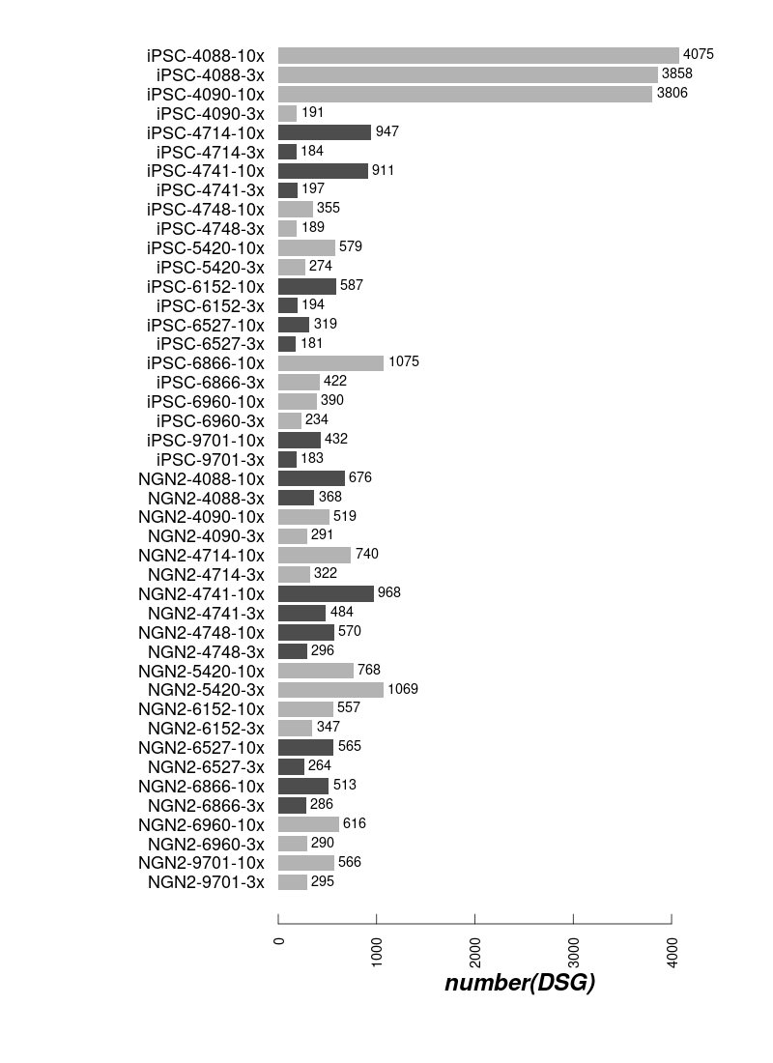
Differential spliced genes

Slide 4
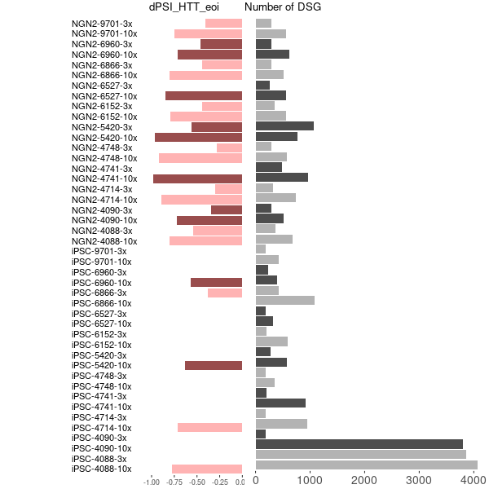
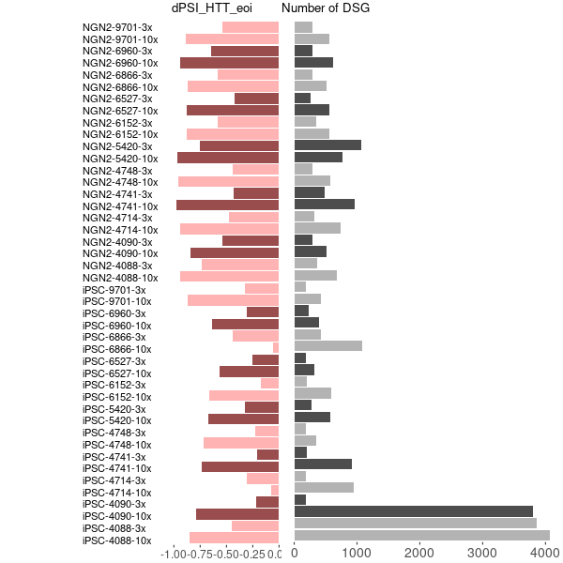

DSG and dPSI in eoi
Updated dPSI from leafcutter
dPSI from majiq
leafcutter majiq merged

Slide 5
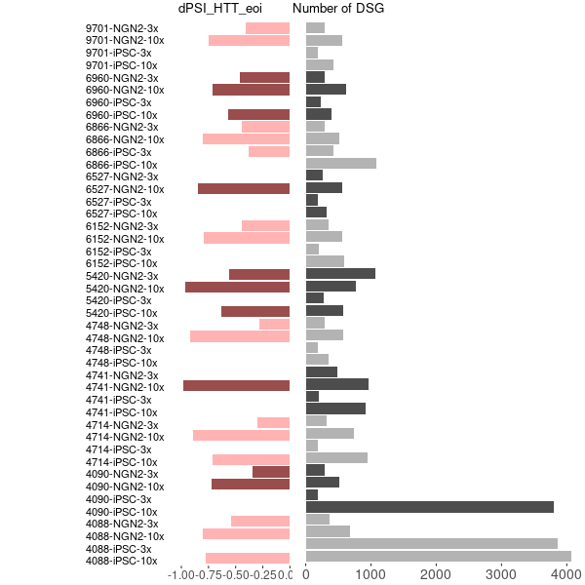
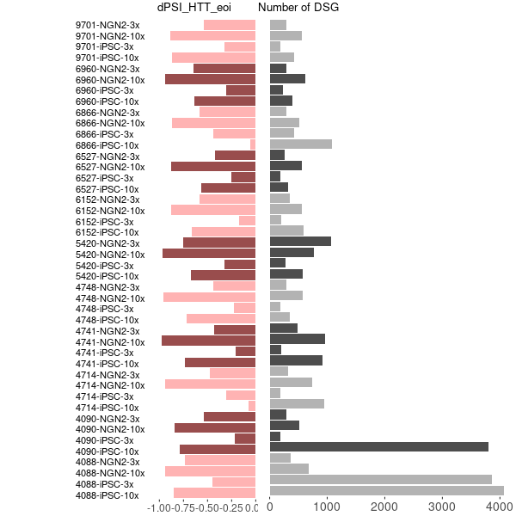
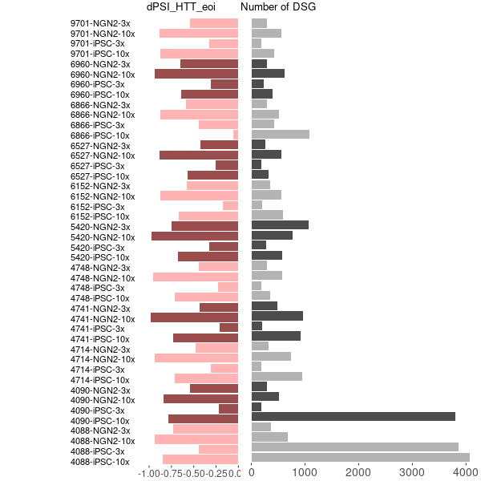
DSG and dPSI in eoi
Updated dPSI from leafcutter
dPSI from majiq
leafcutter majiq merged

Slide 6
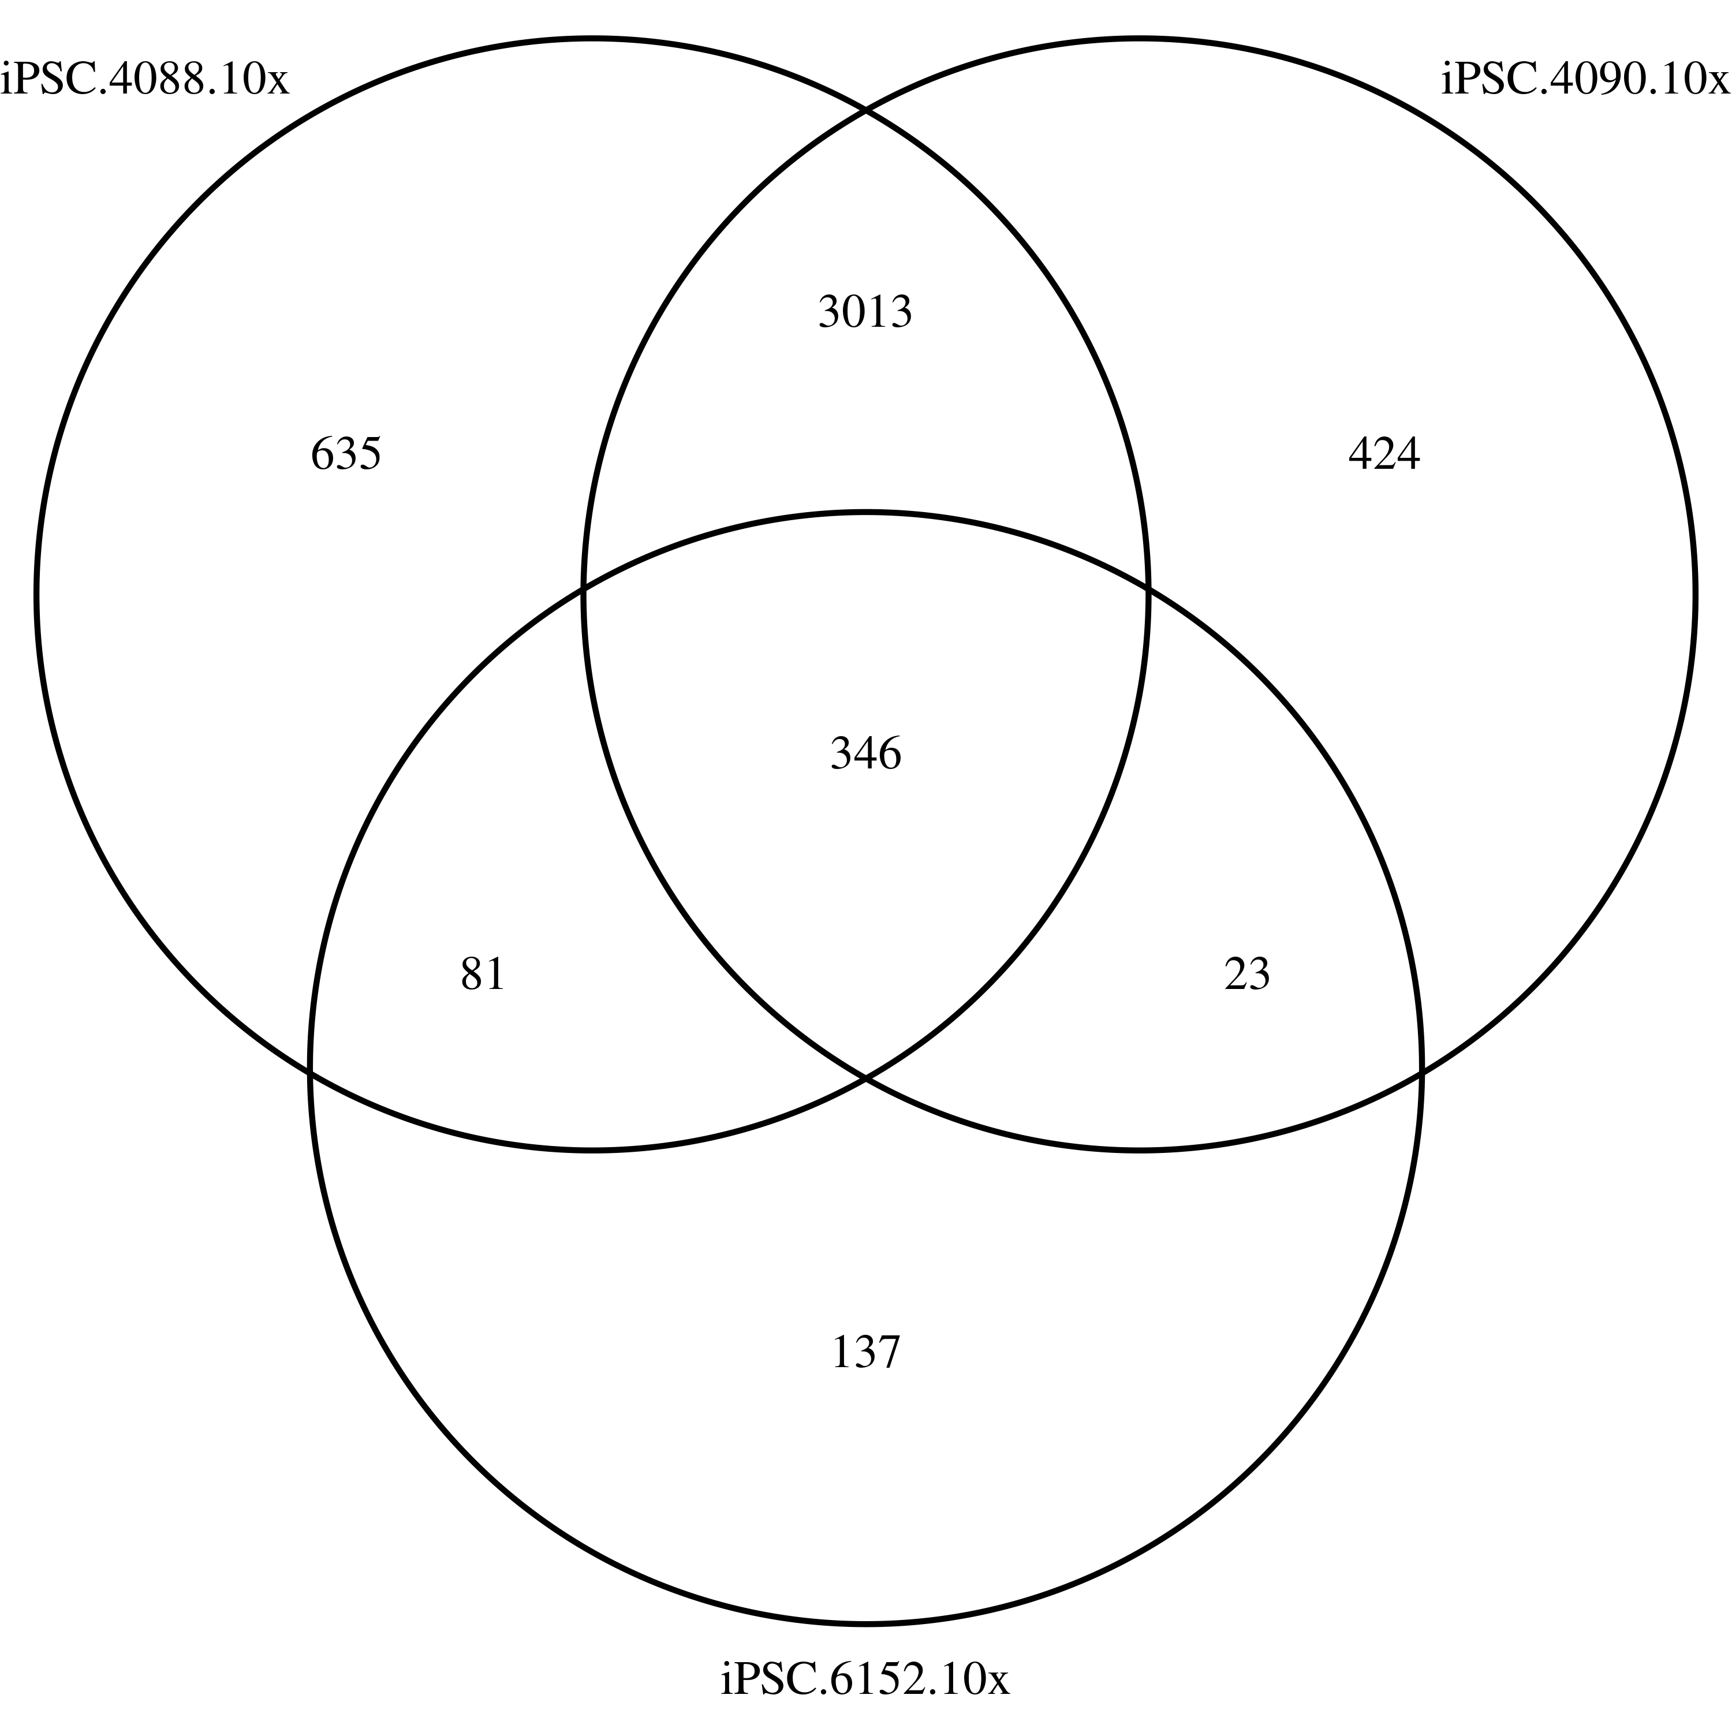
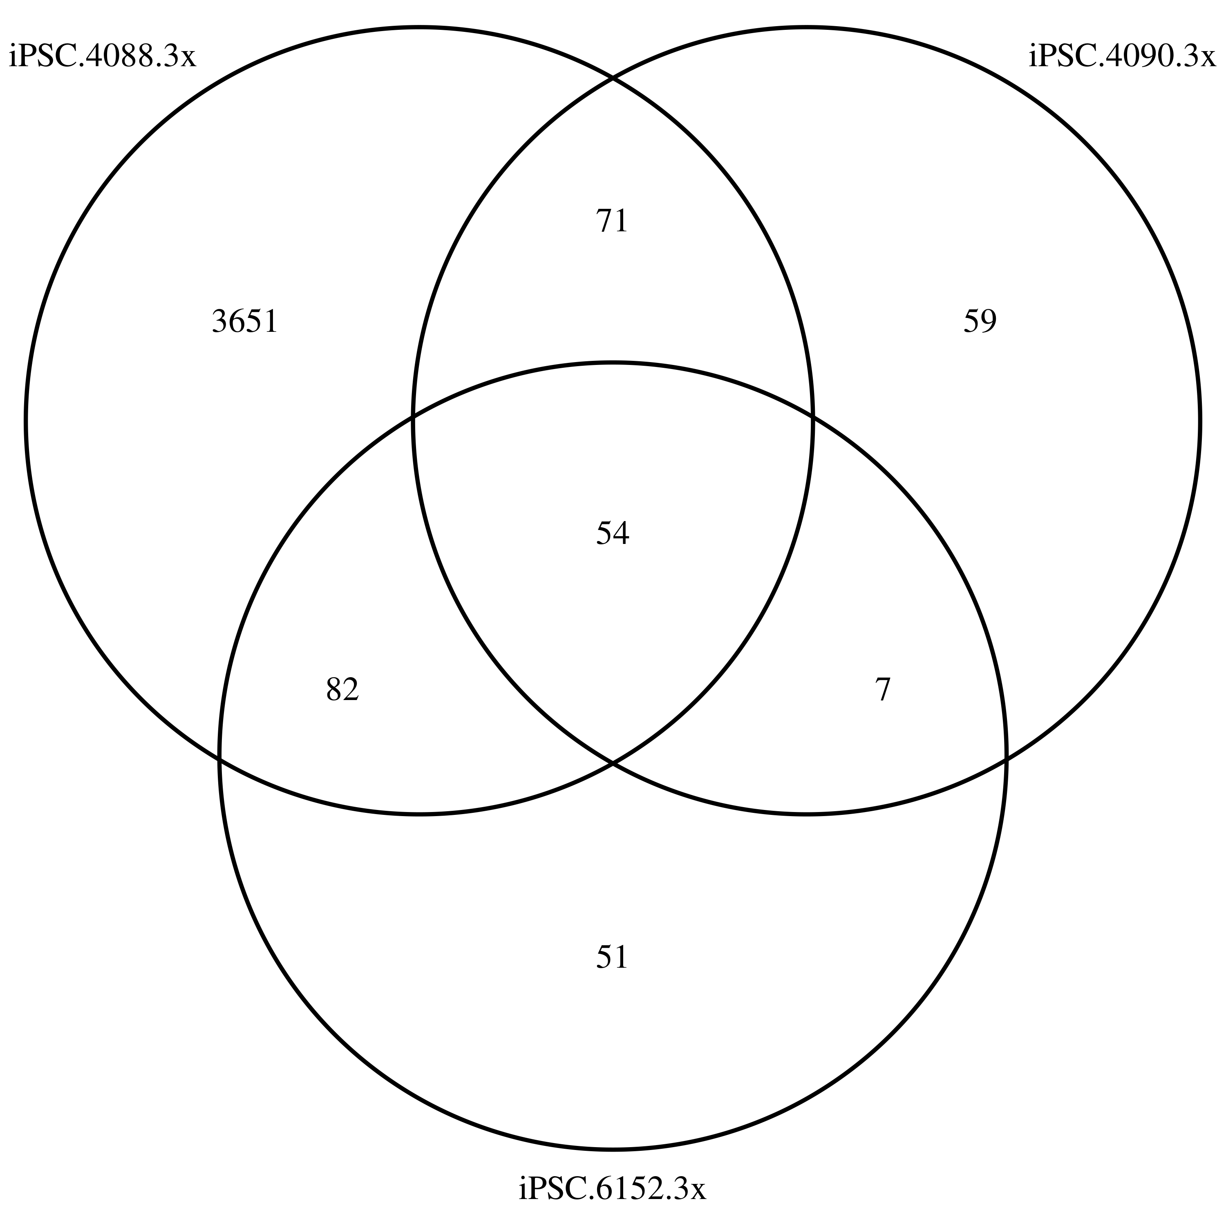
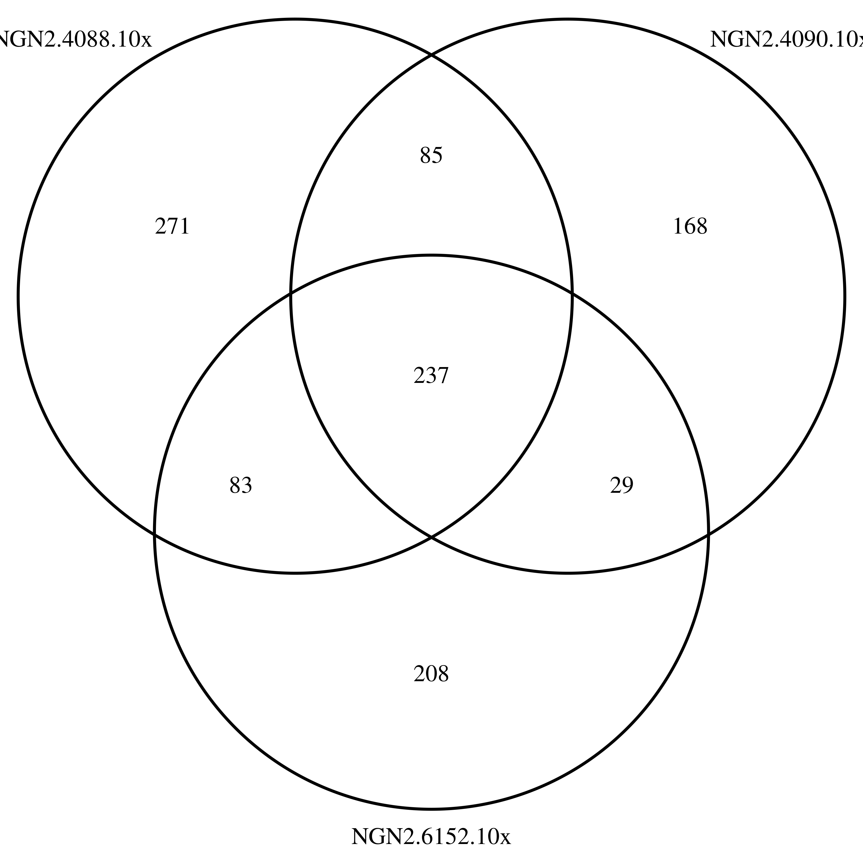
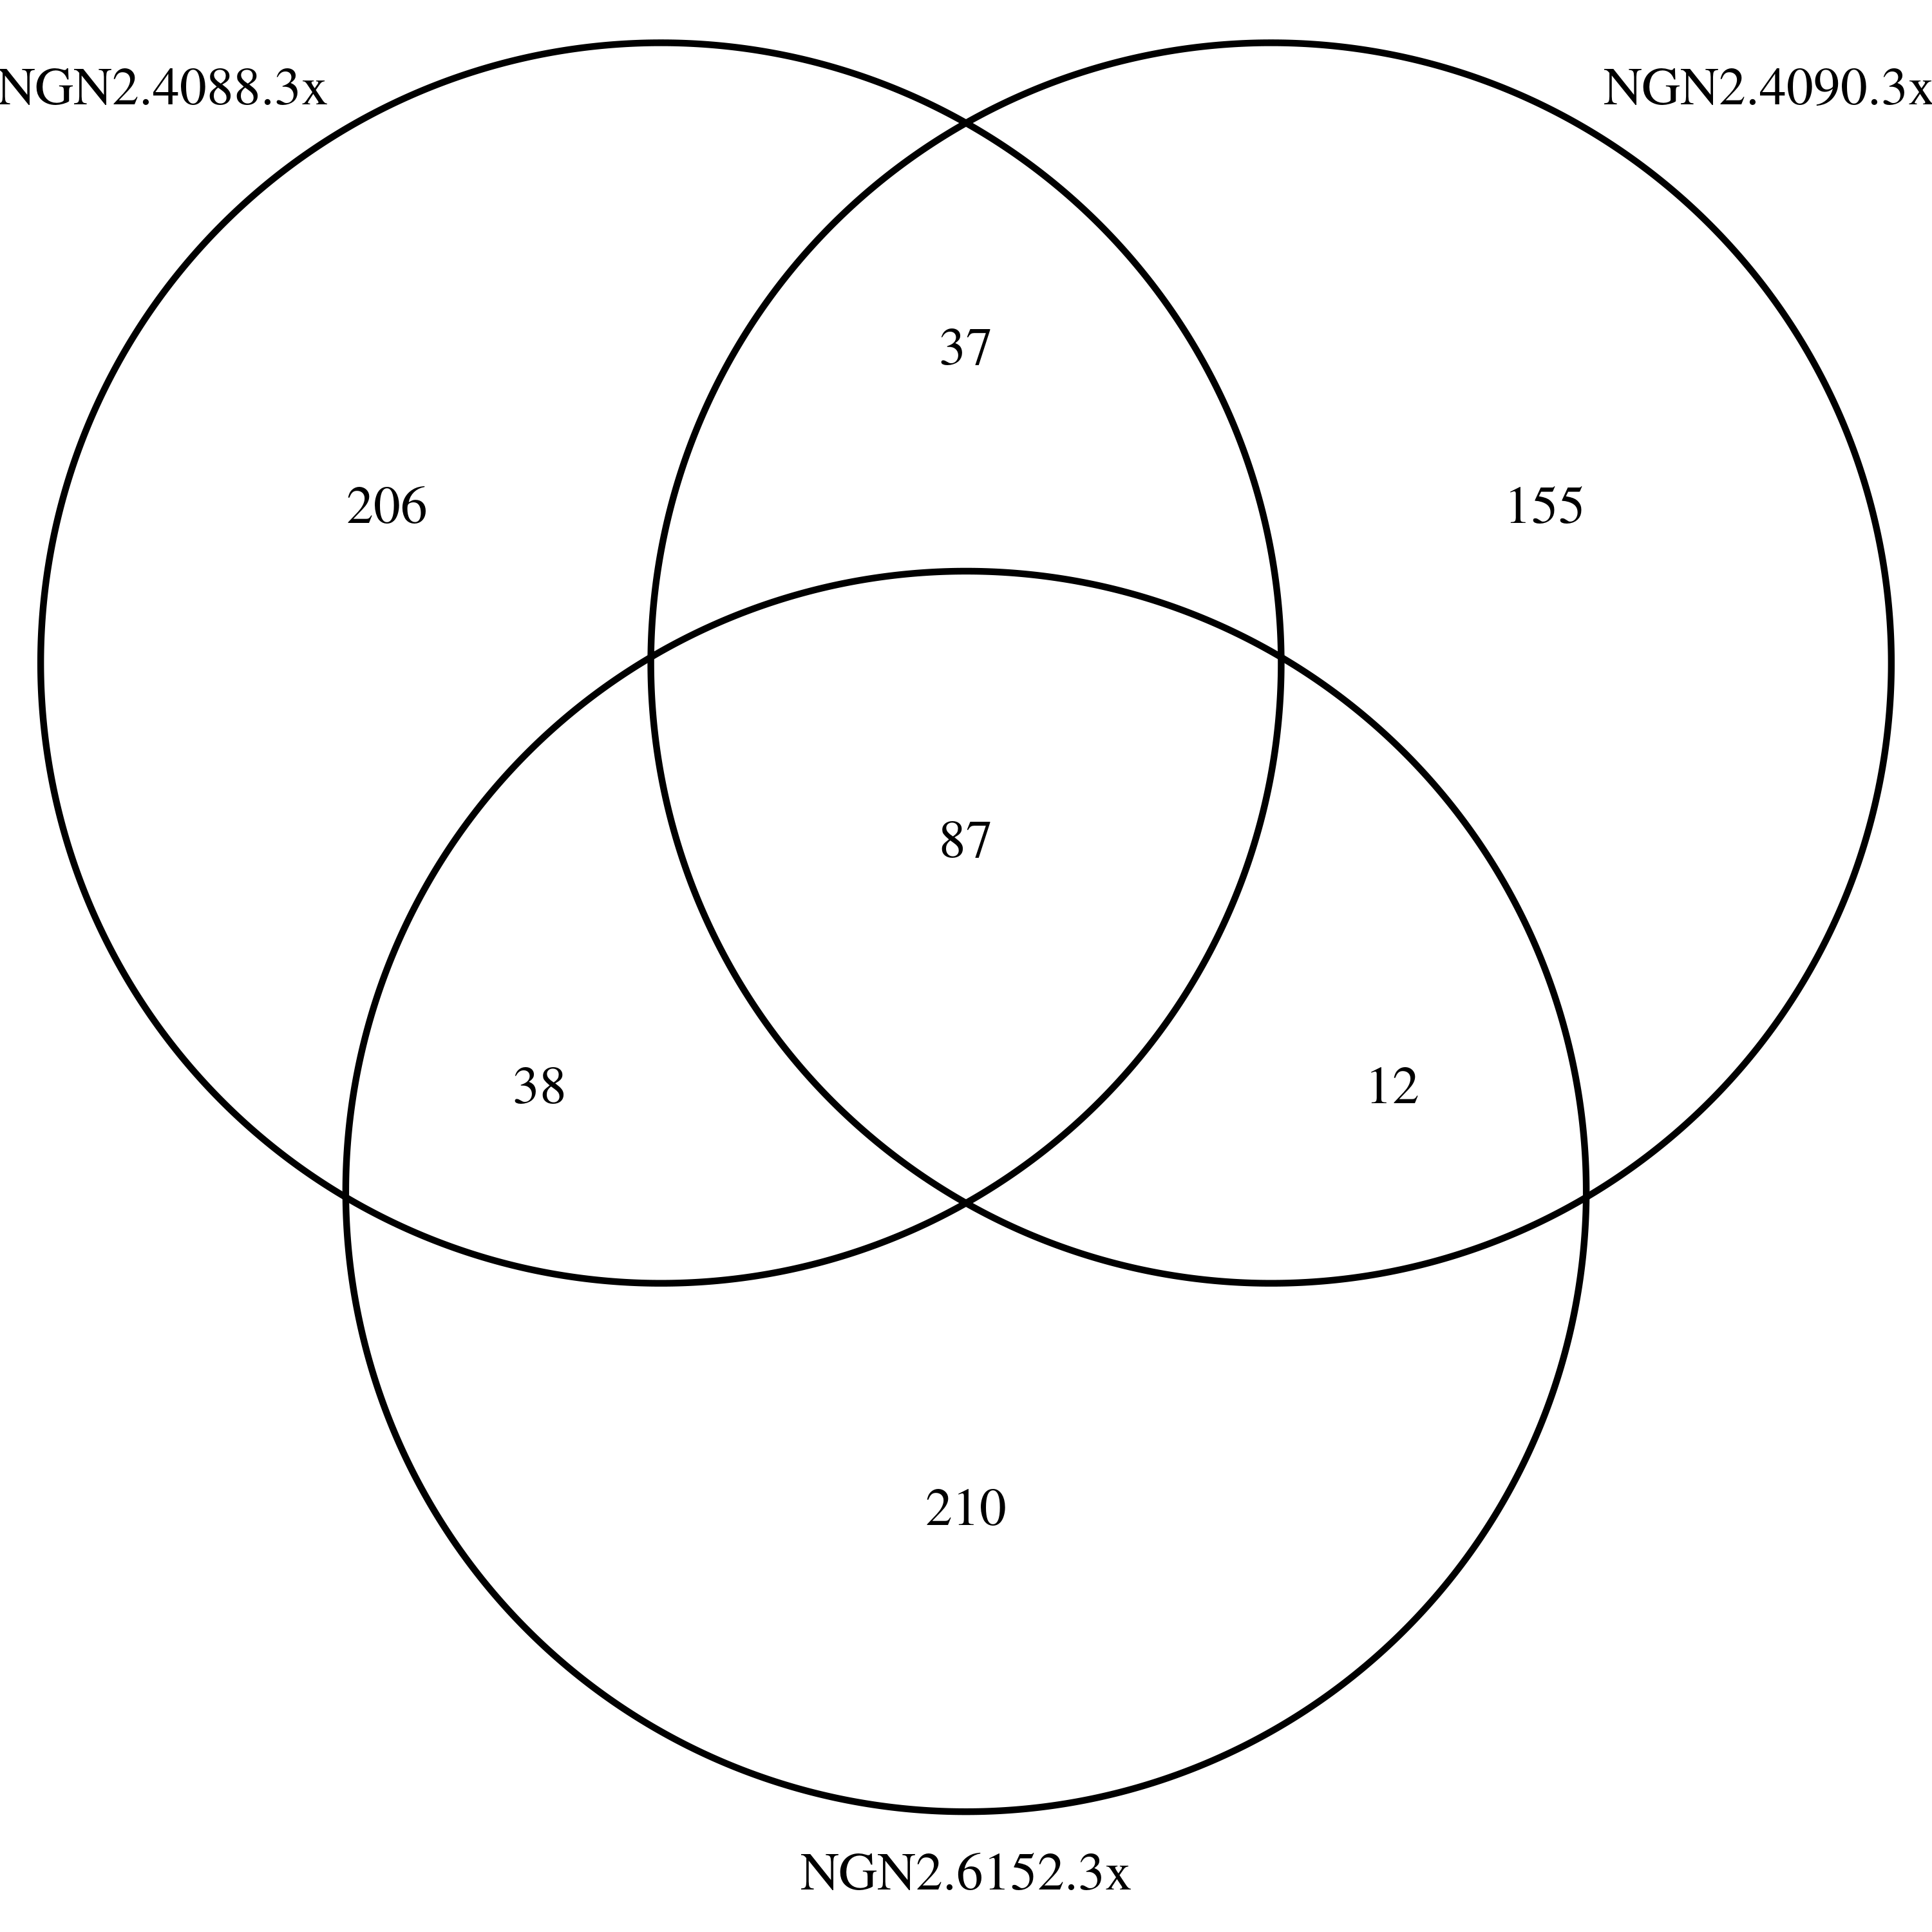
Venn

